Slide 1

Air Quality Monitoring Dashboard
Using Real-Time Data from the IQAir API

Slide 2
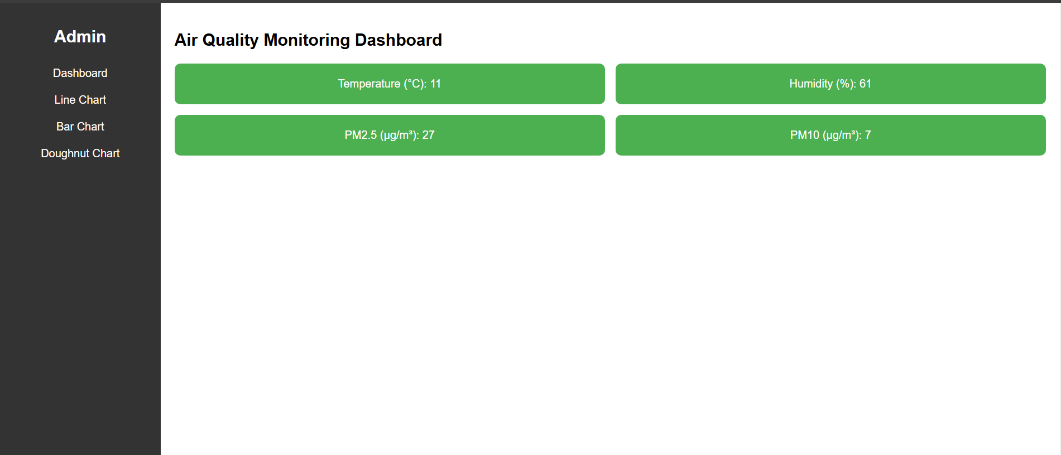
Project Overview
The project monitors real-time air quality metrics using IQAir API.
Visualizes :
Temperature and Humidity (via Line Chart).
PM2.5 and PM10 pollutants (via Bar and Doughnut Charts).
Dashboard displays:
Key data in styled cards.
Interactive charts to explore trends and distribution.
All code is modular, with separate HTML, CSS, and JavaScript files.

Slide 3
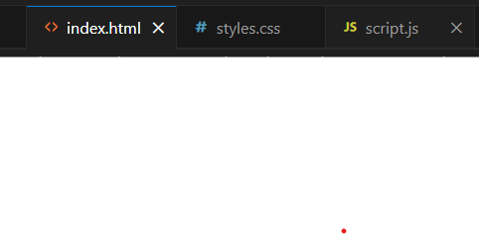
Folder and File Structure
Organized into three main files:
index.html: Defines the interface layout and structure.
styles.css: Manages the appearance and layout styling.
script.js: Fetches data and creates interactive features.
Simple and maintainable structure.

Slide 4
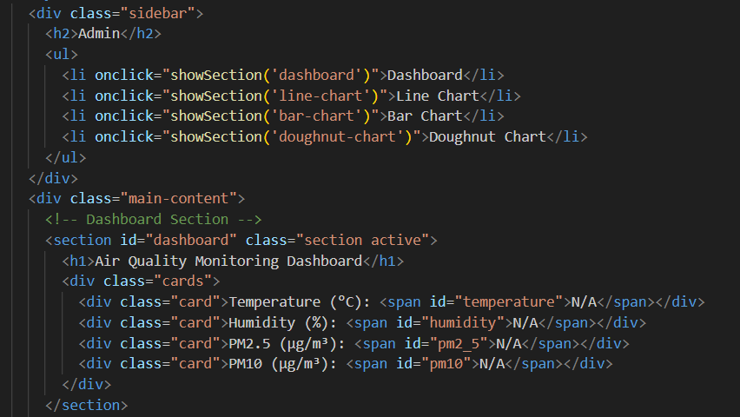
User Interface (HTML)
The interface has two key parts:
Sidebar:
Navigation links for Dashboard, Line Chart, Bar Chart, and Doughnut Chart.
Styled using CSS for alignment and hover effects.
Main Content Area:
Displays data metrics and visualizations.
HTML provides placeholders for the charts and dynamic cards.

Slide 5
Explication of the above code
Contains links for navigation:
Dashboard.
Line Chart.
Bar Chart.
Doughnut Chart.
Clicking these links calls a JavaScript function showSection() to show the corresponding section.
Main Content:
Displays the data and charts.
Dashboard Section:
Includes cards for temperature, humidity, PM2.5, and PM10.
Each card has a span with an id (e.g., id="temperature") where data is dynamically updated by JavaScript.

Slide 6
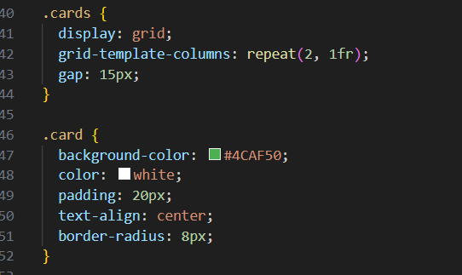
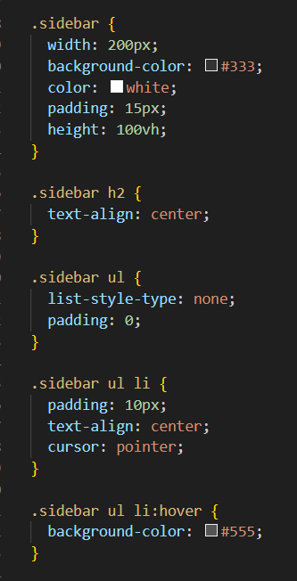
Styling with CSS
Sidebar:
Set background color and spacing for menu items.
Added hover effects for better navigation feedback.
Dashboard:
Cards styled with padding, background color, and border radius for a clean look.
Responsive Design:
Grid layout adapts for different screen sizes.

Slide 7
Explication
Sidebar Styling:
Gives the sidebar a fixed width, background color, and white text.
Adds hover effects on the menu items for better interaction.
Card Styling:
Arranges cards in a grid layout.
Adds spacing (gap) between cards.
Uses rounded corners and background color for a clean, modern look.

Slide 8
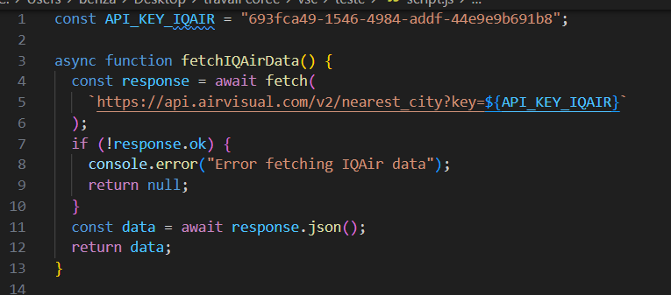
Fetching Real-Time Data with IQAir API
Data fetched from IQAir API for:
Temperature
Humidity
PM2.5 and PM10 pollutant levels.
Data is refreshed every 10 minutes.
Missing data is displayed as "N/A".

Slide 9
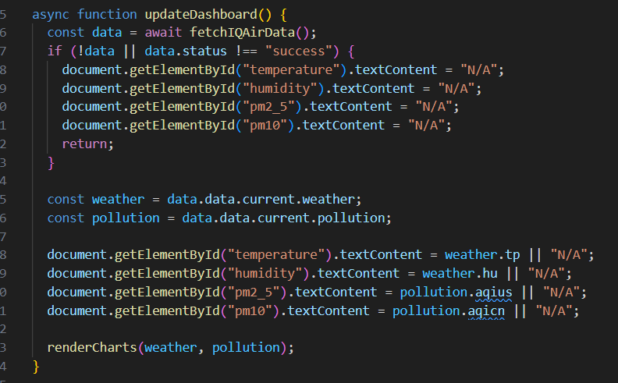
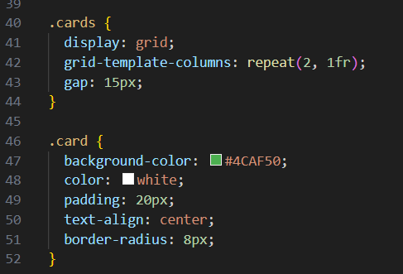
How Metrics are Shown on the Dashboard
updateDashboard dynamically creates and updates cards.
Cards display:
Temperature
Humidity
PM2.5 and PM10 levels.
Cleanly styled using styles.css.

Slide 10
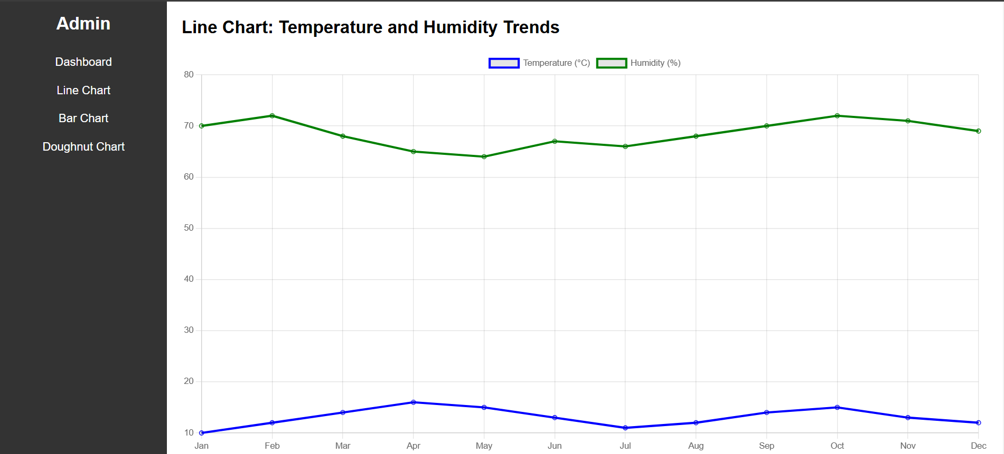
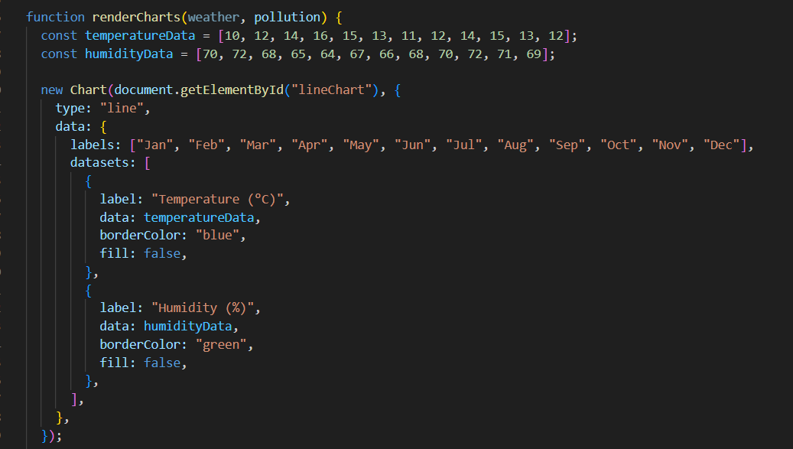
Visualizing Trends: Line Chart
Shows temperature and humidity trends over 12 months.
Data is currently static for demonstration.
Chart created using Chart.js:
Labels: Months.
Two datasets: Temperature and Humidity.
Responsive and interactive.

Slide 11
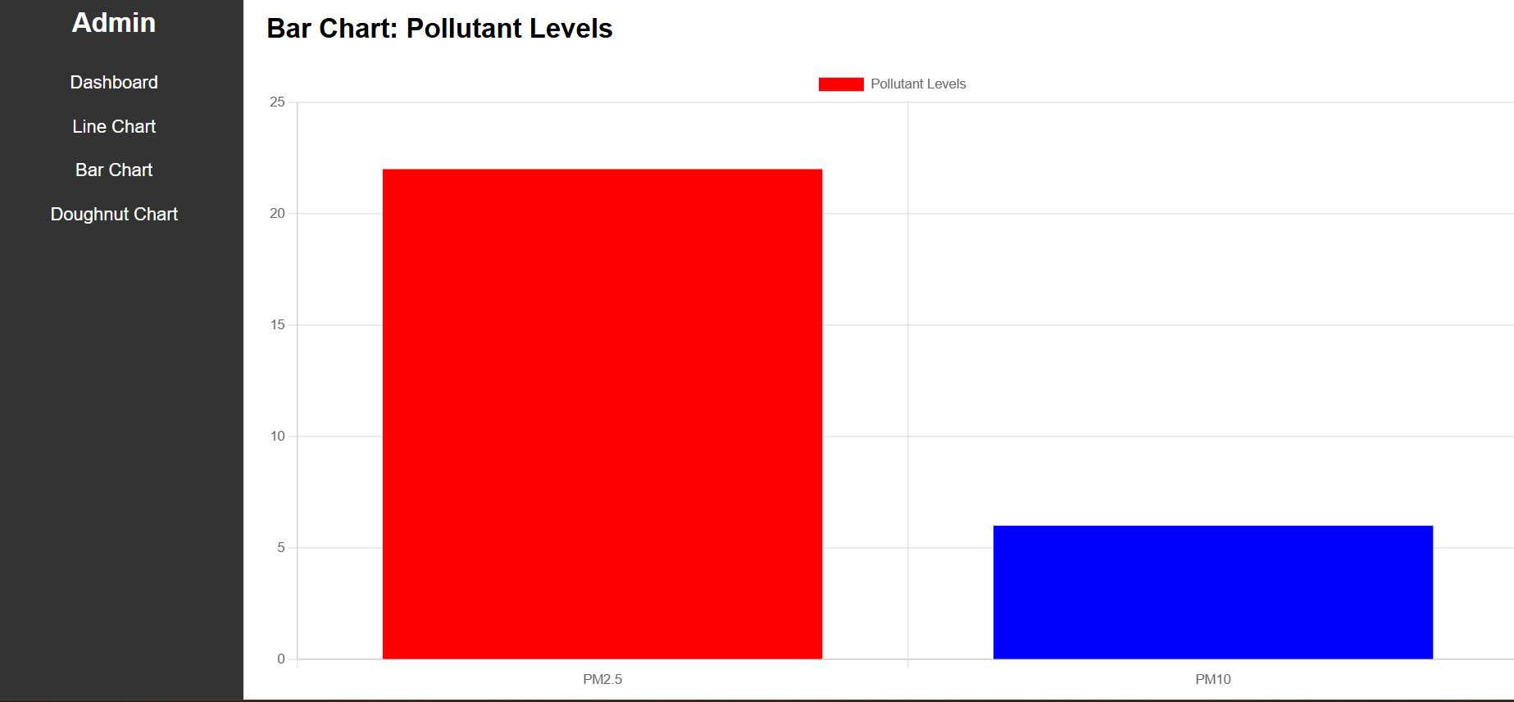
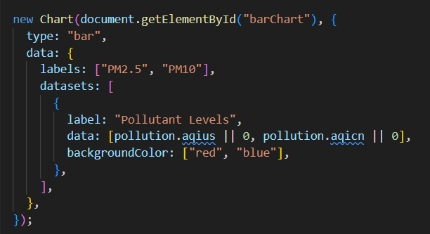
Comparing Pollutants: Bar Chart
Compares PM2.5 and PM10 levels.
Chart.js used for visualization.
Clear comparison with distinct bar colors.

Slide 12
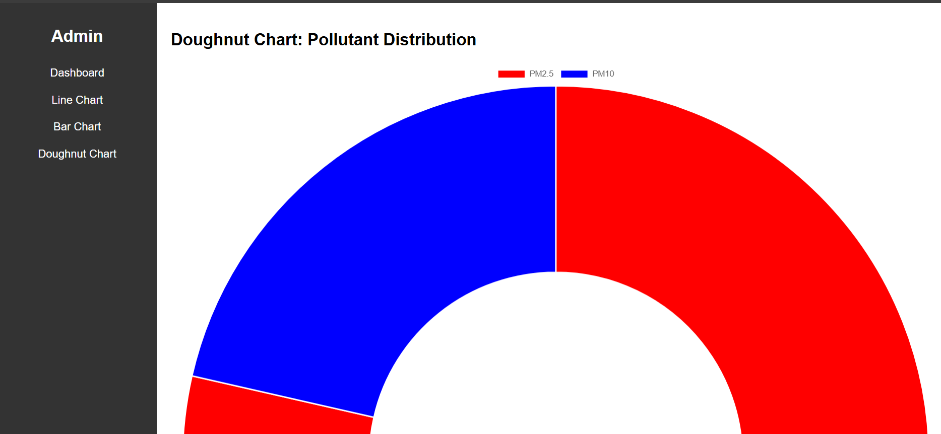
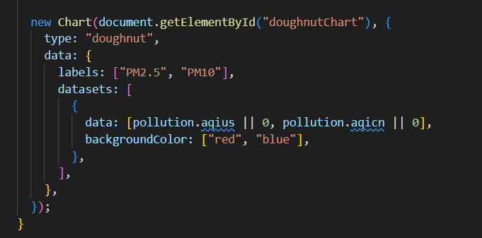
Doughnut Chart
Visualizes the distribution of PM2.5 and PM10 in total pollution.
Interactive and responsive.

Slide 13
What’s Missing and How to Complete It
Real-time Data for All Pollutants
Missing: Accurate data for NOx, NH3, CO2, SO2, and VOC.
How to Complete: Explore and integrate additional APIs (e.g., OpenAQ, Copernicus)
Historical Data for Charts
Missing: Accurate historical data for temperature, humidity, PM2.5, and PM10 over 12 months.
How to Complete:
Use simulated static data arrays for now.
Integrate a historical data API like IQAir's paid tier if feasible.
Dynamic Air Quality Indicators
Missing: Visual indicators (e.g., color-coded badges) to show the severity of air quality levels.
How to Complete: Use conditional logic in JavaScript to dynamically assign colors based on pollutant levels (e.g., green for good, red for poor).
Footer and Additional Sections
Missing: Footer with credits, API documentation links, and legal information.
How to Complete: Add a simple footer in the HTML layout with CSS styling for responsiveness.
Improved Responsiveness
Missing: Better support for mobile and tablet devices.
How to Complete: Use media queries in CSS to adapt the layout for different screen sizes.
Accessibility Enhancements
Missing: Alt text for images, ARIA roles, and semantic HTML for visually impaired users.
How to Complete: Add descriptive alt attributes for images and ARIA roles in the HTML.
Complete Documentation
Missing: A README file detailing setup, usage, and features.
How to Complete: Write a markdown file outlining project requirements, setup instructions, and API usage.

